Slide 1
“walking skeleton” mock-ups

Slide 2
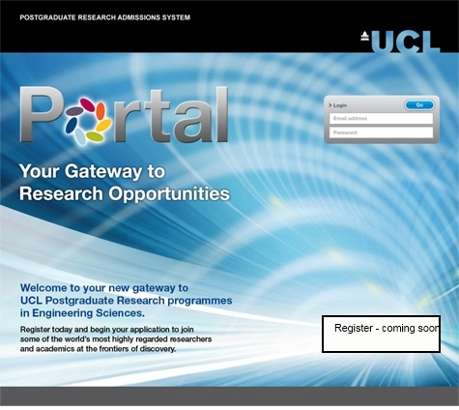
Login

Slide 3
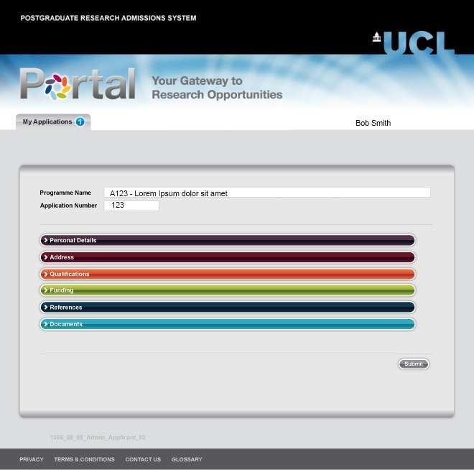
My applications – programme name retained Application number assigned

Slide 4
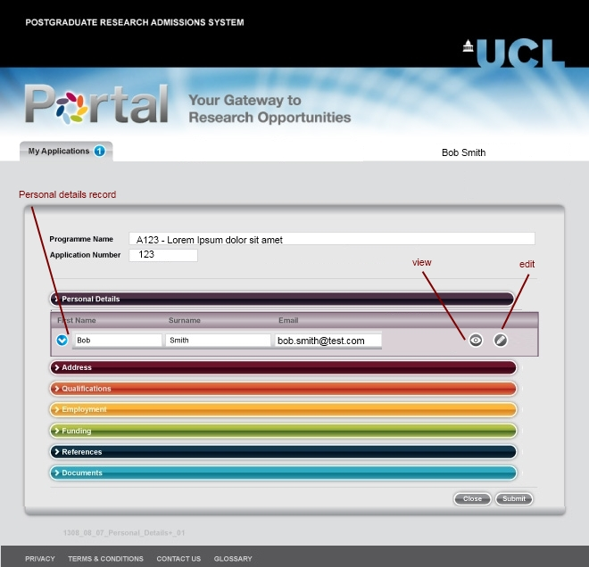
Personal details section
C
“coming soon” text under “employment”

Slide 5
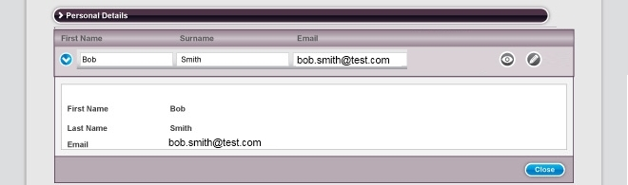
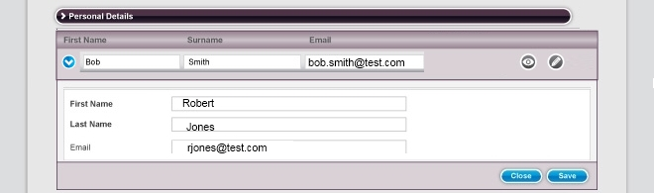

View, edit record
Validations:
First name provided
Last name provided
Email provided
Email valid format

Slide 6
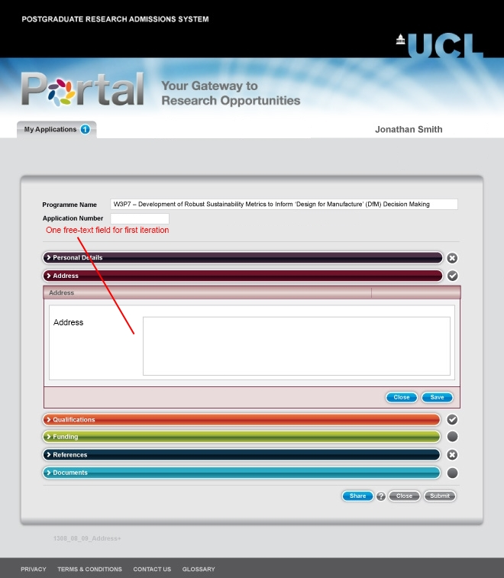
Address
Validations:
Address provided

Slide 7

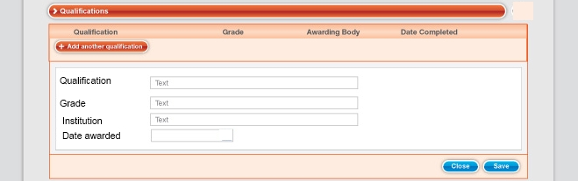
Qualification
Validations:
Qualification provided
Grade provided
Institution provided
Date provided
Date valid

Slide 8
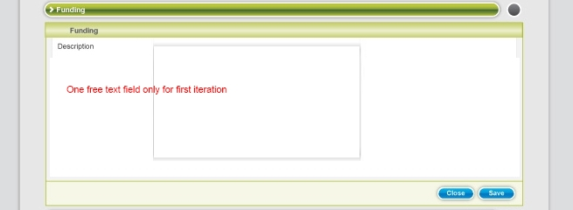
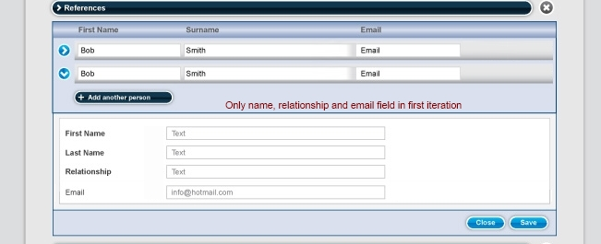
Funding, references
Validations:
Funding provided
Validations:
First name provided
Last name provided
Email provided
Email valid

Slide 9
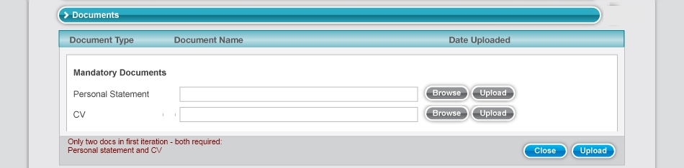
Documents
Validations:
Both doc required
Certain extensions banned, e.g.
“.exe”, “.bat”
(details tbc)

Slide 10
Final submit
Validations:
User details provided
Address provided
At least one qualification provided
Funding description provided
At least one referee provided
CV and Personal statement provided

Slide 11
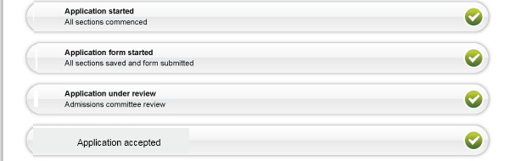
Feedback sections

Slide 12
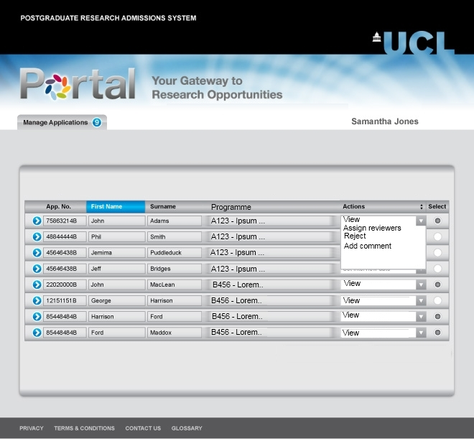
Application List Administrator
Administrator sees all applications for first iteration
Download – coming soon

Slide 13
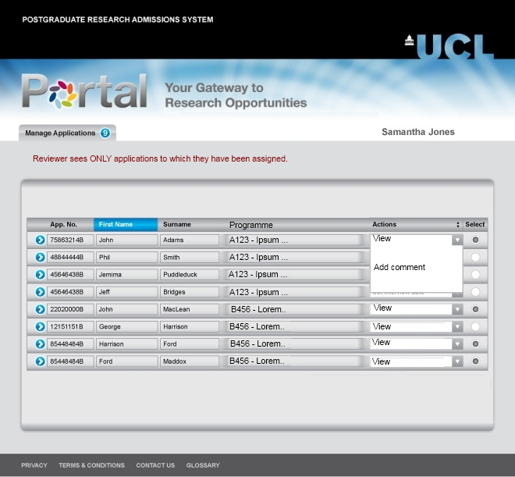
Application List Reviewer
Download – coming soon

Slide 14
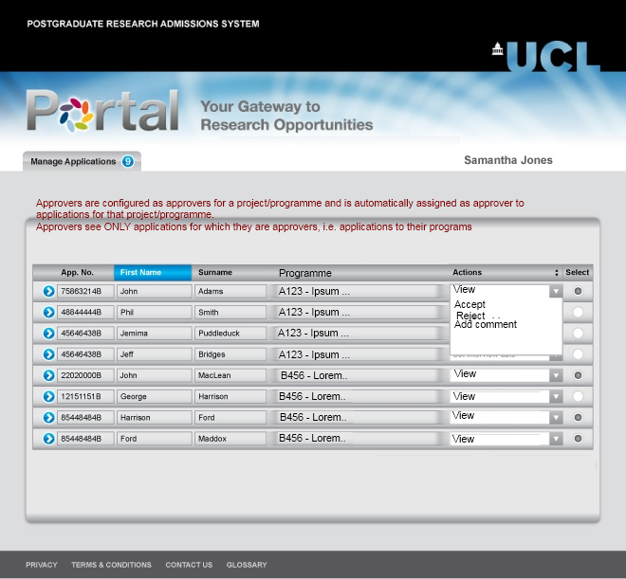
Application List Approver
Download – coming soon

Slide 15
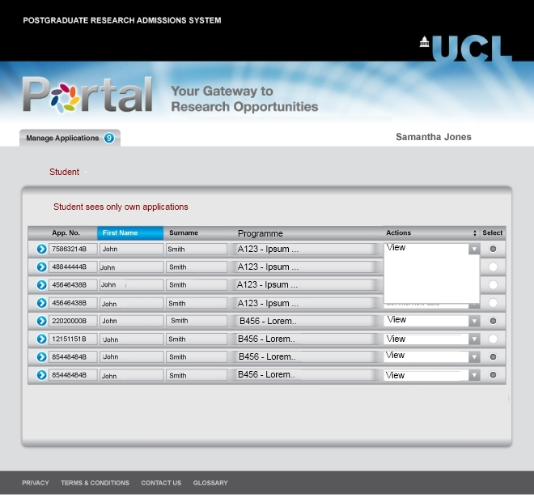
Application List Student
Download – coming soon

Slide 16
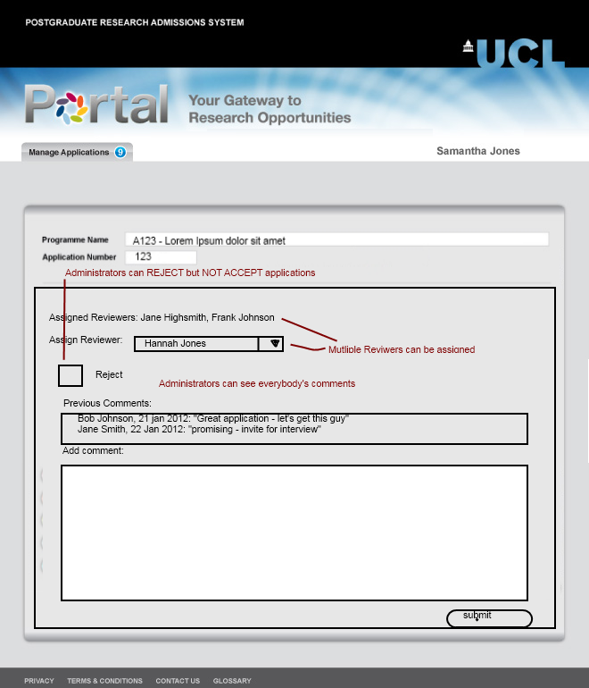
Actions - admin

Slide 17
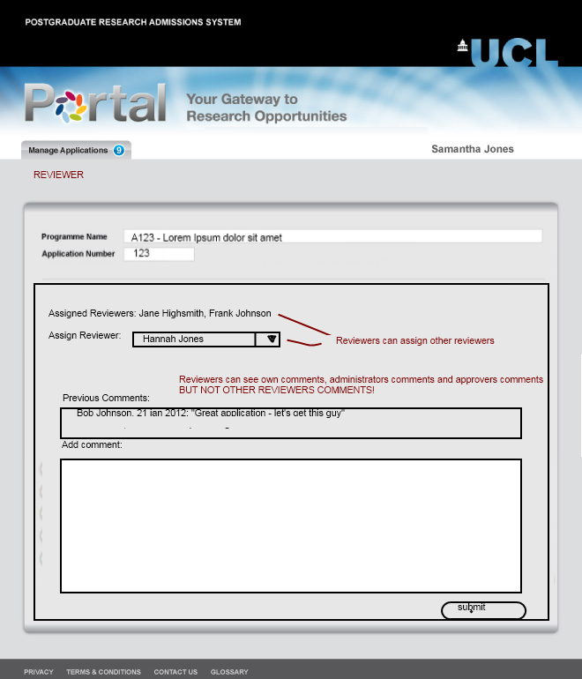
Actions - reviewer

Slide 18
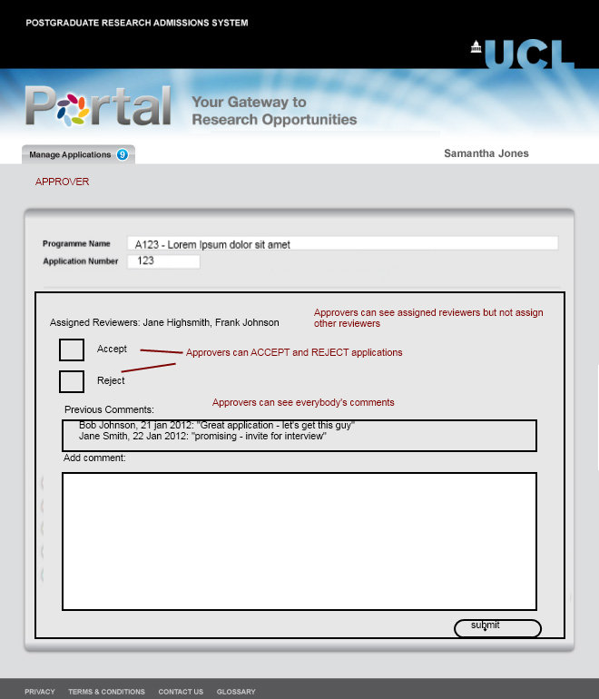
Actions - approver

Slide 19
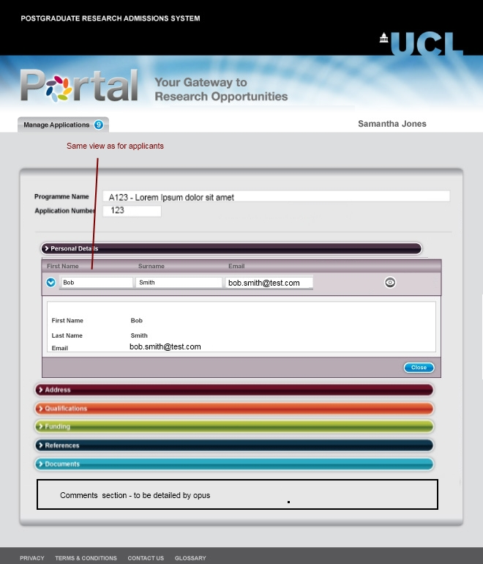
Admin, reviewer, approver view
Same as student’s view, but all sections should be expanded (not shown here due to lack of space….)

